Slide 1
MapReduce

Slide 2
Concept
Logical Functions : Mappers and Reducers
Developers write map and reducer functions then submit a jar to the Hadoop Cluster
Hadoop handles distributing the Map and Reduce tasks across the cluster
Typically Batch-Oriented

Slide 4
Introduction
In Map-Reduce Programming , Jobs(Applications) are spilt into a set of map tasks and reduce tasks .Then these tasks are executed in a different fashion on Hadoop cluster.

Slide 5
Contd…
Each task processes small subset of data that has been assigned to it.This way Hadoop distributes the load across the cluster.MapReduce job takes a set of files that is stored in HDFS as input.MAP Task takes care of loading, parsing, transforming and filtering.

Slide 6
Contd…
The responsibility of Reduce task is grouping and aggregating data that is produced by Map tasks to generate final output.Each MAP task is broken into following phases :
RecordReader
Mapper
Combiner
Partitioner

Slide 7
Contd…
The output produced by Map task is known as intermediate keys and values.These intermediate keys and values are sent to reducer .The reduce tasks are broken into following phases:
Shuffle
Sort
Reducer
Output Format

Slide 8
Hadoop assigns map tasks to the Datanode where the actual data to be processed resides.This way , Hadoop ensures data locality. Data Locality means the data is not moved over network; only computational code is moved to process data which saves network bandwidth.

Slide 9
Record Reader
Converts a byte oriented view of the input into a record oriented view and presents it gto mapper tasks.It presents tasks with keys and values.

Slide 10
MAP
Map Functions works on the key value pair produced by RecordReader and generates zero or more intermediate key-value pairs.The MapReduce decides the key value pair based on the context.

Slide 11
The MAP Side
When map function starts producing output,it is not simply written to the disk but it includes buffering writes and some presorting.Each map writes output to a circular memory buffer (default size 100 MB) assigned to it. When the contents of the buffer reaches a certain threshold size , a background thread will start to spill the contents to disk. Map outputs will continue to be written to the buffer while the spill takes place, but if the buffer fills up during this time, the map will block until the spill is complete.Before it writes to disk, the thread first divides the data into partitions corresponding to the reducers that they will ultimately be sent to. Each time the memory buffer reaches the spill threshold, a new spill file is created, so after the map task has written its last output record, there could be several spill files. Before the task is finished, the spill files are merged into a single partitioned and sorted output file.

Slide 12
Contd…
It is often a good idea to compress the map output as it is written to disk because doing so makes it faster to write to disk, saves disk space, and reduces the amount of data to transfer to the reducer. By default, the output is not compressed, but it is easy to enable this by setting mapred.compress.map.output to true.

Slide 13
Combiner
It is an optional function but provides high performance in terms of network bandwidth and disk space.It takes intermediate key-value pair provided by mapper and applies user specific aggregate function to only that mapper.It is also known as local reducer.

Slide 14
Partitioner
The partitioner takes intermediate key-value pairs produced by the mapper, splits them into shard and sends the shard to the particular reducer as per the user-specific code.

Slide 15
REDUCER
Shuffle and Sort – This phase takes the output of all the partitioners and downloads them into the local machine where the reducer is running.Then these individual data pipes are sorted by keys .
Reduce- Takes the grouped data , applies reduce function and processes one group at a time .The reducer function iterates all the values associated with that key.Reducer operation provides various operations such as aggregation, filtering and combining data.Once it is done , the output of reducer is sent to the output format.

Slide 16
The Reduce Side
The reduce task needs the map output for its particular partition from several map tasks across the cluster. The map tasks may finish at different times, so the reduce task starts copying their outputs as soon as each completes. This is known as the copy phase of the reduce task. The reduce task has a small number of copier threads so that it can fetch map outputs in parallel. The default is five threads, but this number can be changed by setting the mapred.reduce.parallel.copies property.

Slide 17
Contd…
The map outputs are copied to the reduce task JVM’s memory if they are small enough (the buffer’s size is controlled by mapred.job.shuffle.input.buffer.percent, which specifies the proportion of the heap to use for this purpose); otherwise, they are copied to disk. When the in-memory buffer reaches a threshold size (controlled by mapred.job.shuffle.merge.percent) or reaches a threshold number of map outputs (mapred.inmem.merge.threshold), it is merged and spilled to disk. If a combiner is specified, it will be run during the merge to reduce the amount of data written to disk. As the copies accumulate on disk, a background thread merges them into larger, sorted files. This saves some time merging later on. Note that any map outputs that were compressed (by the map task) have to be decompressed in memory in order to perform a merge on them.

Slide 18
Contd…
When all the map outputs have been copied, the reduce task moves into the sort phase (which should properly be called the merge phase, as the sorting was carried out on the map side), which merges the map outputs, maintaining their sort ordering. This is done in rounds. For example, if there were 50 map outputs and the merge factor was 10 (the default, controlled by the io.sort.factor property, just like in the map’s merge), there would be five rounds. Each round would merge 10 files into one, so at the end there would be five intermediate files. Rather than have a final round that merges these five files into a single sorted file, the merge saves a trip to disk by directly feeding the reduce function in what is the last phase: the reduce phase. This final merge can come from a mixture of in-memory and on-disk segments.

Slide 19
Contd…
During the reduce phase, the reduce function is invoked for each key in the sorted output. The output of this phase is written directly to the output filesystem, typically HDFS. In the case of HDFS, because the tasktracker node (or node manager) is also running a datanode, the first block replica will be written to the local disk.

Slide 20
Shuffle and Sort
MapReduce makes the guarantee that the input to every reducer is sorted by key.The process by which the system performes the sort and transfers the map outputs to the reducers as inputs is known as shuffle.In many ways, the shuffle is the heart of MapReduce.

Slide 21
OUTPUT FORMAT
The output format separates key-value pair with tab (default) and writes it out to a file using record writer.

Slide 22
Map Reduce-What?
MapReduce is a programming model for efficient distributed computing
It works like a Unix pipeline
cat input | grep | sort | uniq -c | cat > output
Input | Map | Shuffle & Sort | Reduce | Output
Efficiency from
Streaming through data, reducing seeks
Pipelining
A good fit for a lot of applications
Log processing
Web index building

Slide 23
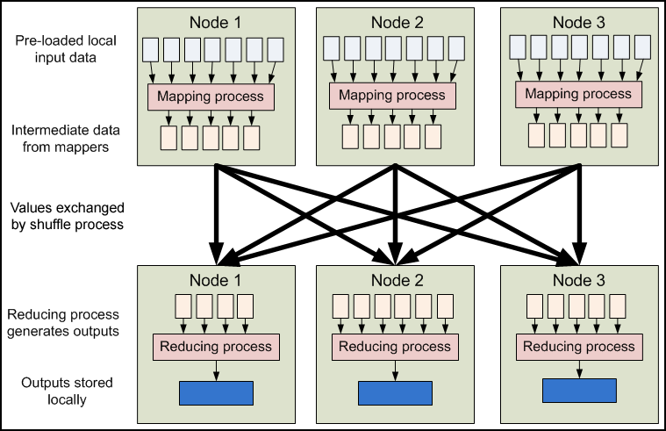
Map Reduce : Data Flow

Slide 24
Map Reduce : Features
Fine grained Map and Reduce tasks
Improved load balancing
Faster recovery from failed tasks
Automatic re-execution on failure
In a large cluster, some nodes are always slow or flaky
Framework re-executes failed tasks
Locality optimizations
With large data, bandwidth to data is a problem
Map-Reduce + HDFS is a very effective solution
Map-Reduce queries HDFS for locations of input data
Map tasks are scheduled close to the inputs when possible

Slide 25
Scaling a simple Program Manually
Count the number of times each word occurs in a set of documents. In this example , we have a set of documents having only one document with only one sentence:
Do as I say, not as I do.
as 2
Do 2
I 2
Not 1
Say 1

Slide 26
Contd…
define wordCount as Multiset;
for each document in documentSet {
T = tokenize(document);
for each token in T {
wordCount [token]++;
}
}
Display(wordCount);
For each document, the words are extracted one by one using a tokenization process.A multiset is a set where each element also has a count.This program works fine until the set of documents you want to process becomes large.e.g., you want to build a spam filter to know the words frequently used in the millions of spam emails you have received.Looping through all the documents using a single computer will be extremely time consuming.

Slide 27
Issues with the program
Another flaw with this program is that wordCount are stored in memory.When processing large document sets, the number of unique words can exceed the RAM storage of machine.Looking into growing complexities of wordCount program , we need to add functionalities:
- Store files over many processing machines
- write a disk-based hash table permitting processing without being limited by RAM capacity
- Partition the intermediate data
- Shuffle the partitions to the appropriate machines in phase 2

Slide 28
Scaling the same program in Map Reduce
MapReduce programs are executed in two phases: mapping and Reducing.Each phase is defined by a data processing function and these functions are called mapper and reducer.
Mapper-MapReduce takes input dataand feeds each data element to the mapper.
Reducer-processes all the outputs from the mapper and arrives at a final result.
Mapper is meant to filter and transform the input into something that the reducer can aggregate over.
Partitioning and shuffling are common design patterns that go along with mapping and reducing.

Slide 29
List-Key Value Pairs
 | Input | Output
Map | <k1,v1> | list(<k2,v2>)
reduce | <k2,list(v2)> | List(<k3,v3>)

Slide 30
Contd…
In Map Reduce framework you write applicationsby specifying the mapper and reducer.
The input to your applications must be structured as a list of (key/value) pairs, list(<k1,v1>).The input format for processing multiple files is usually list(<String filename,String file_content>).The input format for processing one large file, such as a log file is , list(<integer line_number,String log_event>).
The list of (key/value) pairs is broken up and each individual (key/value) pair <k1,v1>, is processed by calling the map function of the mapper.
The output of all mappers are aggregated into one giant list of <k2,v2> pairs.All pairs sharing the same k2 are grouped together into a new (key/value) pair , <k2,list(v2)>.The framework asks reducer to process each one of these aggregated pairs individually.

Slide 31
Word Count Example
Mapper
Input: value: lines of text of input
Output: key: word, value: 1
Reducer
Input: key: word, value: set of counts
Output: key: word, value: sum
Launching program
Defines this job
Submits job to cluster

Slide 32
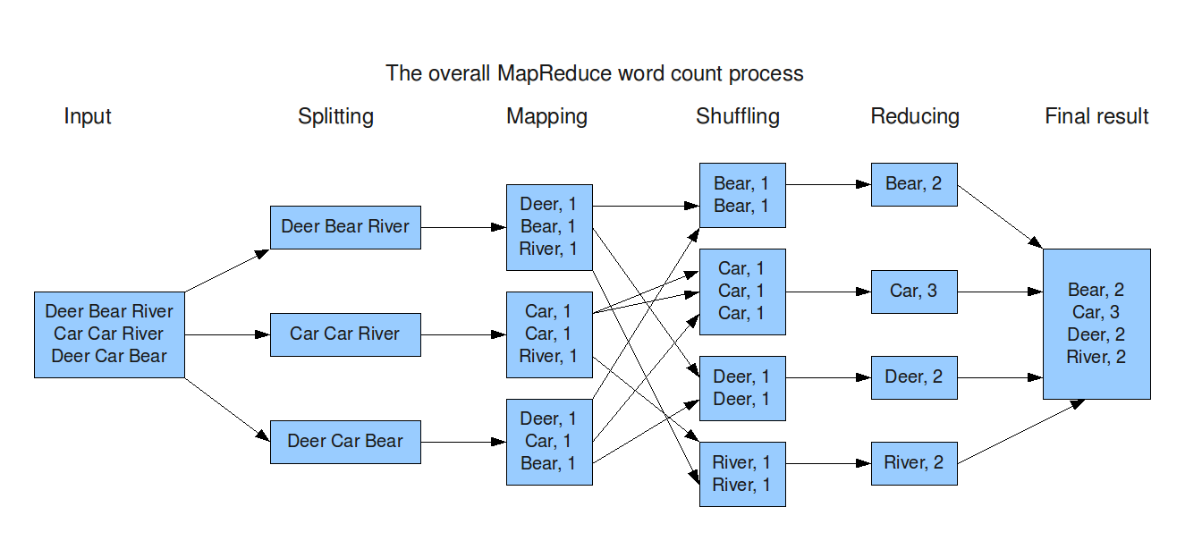
Word count Data Flow

Slide 33
Word count Mapper
public static class Map extends MapReduceBase implements Mapper<LongWritable,Text,Text,IntWritable> {
private static final IntWritable one = new IntWritable(1);
private Text word = new Text();
public static void map(LongWritable key, Text value, OutputCollector<Text,IntWritable> output, Reporter reporter) throws IOException {
String line = value.toString();
StringTokenizer = new StringTokenizer(line);
while(tokenizer.hasNext()) {
word.set(tokenizer.nextToken());
output.collect(word,one);
}
}
}

Slide 34
Word count Reducer
public static class Reduce extends MapReduceBase implements Reducer<Text,IntWritable,Text,IntWritable> {
public static void map(Text key, Iterator<IntWritable> values, OutputCollector<Text,IntWritable> output, Reporter reporter) throws IOException {
int sum = 0;
while(values.hasNext()) {
sum += values.next().get();
}
output.collect(key, new IntWritable(sum));
}
}

Slide 35
Word count Examples
Jobs are controlled by configuring JobConfs
JobConfs are maps from attribute names to string values
The framework defines attributes to control how the job is executed
conf.set(“mapred.job.name”, “MyApp”);
Applications can add arbitrary values to the JobConf
conf.set(“my.string”, “foo”);
conf.set(“my.integer”, 12);
JobConf is available to all tasks

Slide 36
Input and Output Formats
A Map/Reduce may specify how it’s input is to be read by specifying an InputFormat to be used
A Map/Reduce may specify how it’s output is to be written by specifying an OutputFormat to be used
These default to TextInputFormat and TextOutputFormat, which process line-based text data
Another common choice is SequenceFileInputFormat and SequenceFileOutputFormat for binary data
These are file-based, but they are not required to be

Slide 37
Contd…
Logical Functions : Mappers and Reducers
Developers write map and reducer functions then submit a jar to the Hadoop Cluster
Hadoop handles distributing the Map and Reduce tasks across the cluster
Typically Batch-Oriented

